Slide 1
Chapter 7: Deriving Use Cases from Requirements part 2 - Steps for Use Case Derivation

Slide 2
Key Takeaway Points
A use case is a business process; it begins with an actor, ends with the actor, and accomplishes a business task for the actor.
Use cases are derived from requirements and satisfy the requirements.
Planning the development and deployment of use cases and subsystems to meet the customer’s business needs and priorities.
7-<number>

Slide 3
Deriving Use Cases in the Methodology Context
Business goals
& needs
Current situation
Use case-iteration allocation matrix
Accommodating
Requirements Change
Customer
feedback
Acquiring
Requirements
(Domain Modeling)
Iteration use cases
Domain Modeling
Preliminary requirements
Domain model
Domain model
Deriving Use Cases
from Requirements
Actor-System Interaction Modeling
Abstract & high level use cases, use case diagrams
Expanded use cases & UI design
Allocating Use Cases & Subsystems
to Iterations
Behavior Modeling &
Responsibility Assignment
Behavior models
Use case-iteration allocation matrix
Deriving Design Class
Diagram
Producing an Architecture Design
Design class diagram
Software architecture
Test Driven Development, Integration, & Deployment
(a) Planning Phase
(b) Iterative Phase – activities during each iteration
control flow
data flow
control flow & data flow
7-<number>

Slide 4
Use Case and UML Use Case Diagram
Use case and UML use case diagram
  click above link if coverage of UML use case diagram is needed, else continue to the next slide
7-<number>

Slide 5
What Is a Use Case?
A use case is a business process.
A use case must be initiated by an actor.
A use case must end with the actor.
  The actor explicitly or implicitly acknowledges the accomplishment of the business task.
A use case must accomplish a business task (for the actor).
7-<number>

Slide 6
What Is an Actor?
An actor denotes a business role played by (and on behalf of) a set of business entities or stakeholders.
Actors are not part of the system.
Actors interact with the system.
Actors are often human beings but can also be a piece of hardware, a system, or another component of the system.
Actors initiate use cases, which accomplish business tasks for the respective actors.
7-<number>

Slide 7

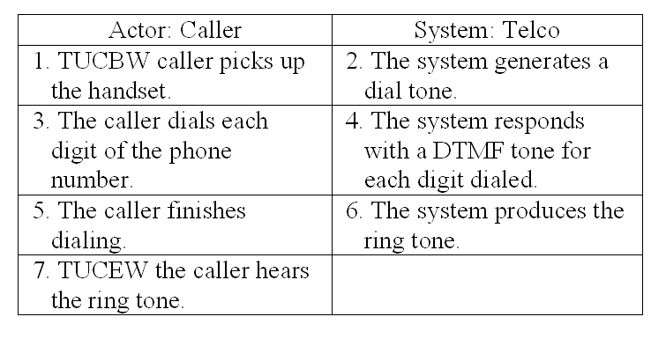
Use Case Modeling Steps
planning phase
iterative phase
Deriving use cases
from requirements
requirements
abstract use cases
(e.g., Initiate a Call)
Defining use case scope
abstract &
high level use cases
Example high level use case:
TUCBW caller picks handset from base
TUCEW caller hears the ring tone.
Telco
Initiate a Call
Answer a Call
Specifying actor-
system interaction
(expanded use cases)
Depicting use case contexts
7-<number>

Slide 8
Deriving Use Cases from Requirements
In the requirements specification, look for verb noun phrases that indicate domain specific
  “do something”
  “something must be done” or
  “perform some task”
  in the application domain.
Verify the verb noun phrases using use case definition (next slide).
7-<number>

Slide 9
Verify the Use Cases Identified
Verify the use cases identified using use case definition:
  (1) Is it a business process? y/n
  (2) Is it initiated啟動 by an actor? y/n
  (3) Does it end with the actor? y/n
  (4) Does it accomplish something useful for the actor? y/n
All the answers to above questions must be “y.”
7-<number>

Slide 10
Identify Actor, System or Subsystem
From the requirements, identify also
  the actors, who initiate the tasks, or for whom the tasks are performed
  the system or subsystem that contains the use case
7-<number>

Slide 11
Example: Library System
Requirements of a library system:
R1. The library system must allow a patron to
check out documents.
R2. The library system must allow a patron to
return documents.
7-<number>

Slide 12
Use Case Diagram: Library Example
system name
use case
actor
Library System
Checkout Document
Return Document
Patron
Search for Document
association
system boundary
7-<number>

Slide 13
Example: Oversea Exchange Program
R1. The web-based application must provide a search capability for overseas exchange programs using a variety of search criteria.
R2. The web site must provide a hierarchical display of the search results to facilitate user navigation from a high level summary to details about an overseas exchange program.
7-<number>

Slide 14
Business Process, Step, Operation and Action
A business process is a series of steps to accomplish a complete business task.
An operation is a series of actions or instructions to accomplish a step of a business process.
7-<number>

Slide 15
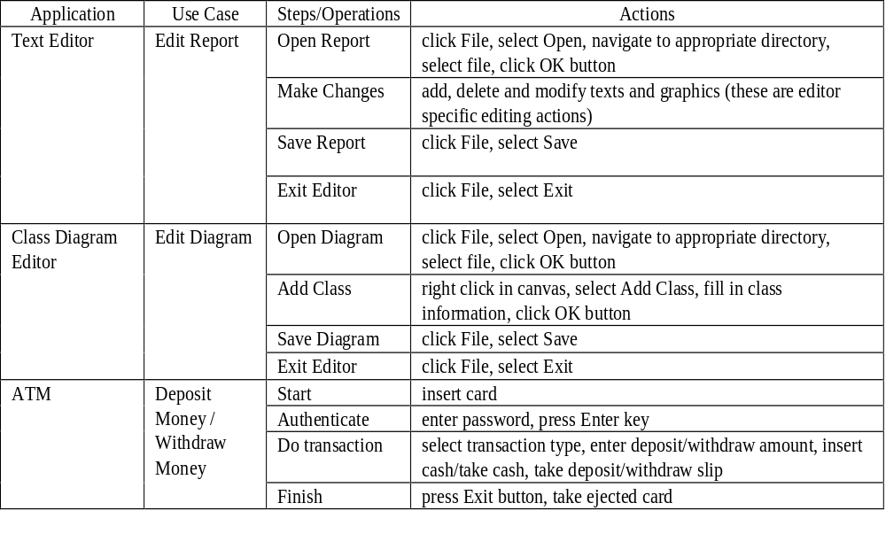
Business Process, Step, Operation and Action
7-<number>

Slide 16
Are the followings use cases? Why?
Check authorization / check authentication
Enter a password
Process data
Open a file
Click on a menu item
Traverse a linked list.
Start a system
7-<number>

Slide 17
Use Case Specification: 3 Levels of Abstraction
Abstract use case: a verb-noun phrase
High level use case: when and where the use case begins and when it ends
  TUCBW (This use case begins with ...)
  TUCEW (This use case ends with ...)
Expanded use case: step-by-step description of how the actor interacts with the system to carry out the business process
7-<number>

Slide 18
Abstract Use Case and High level Use Case
Abstract use case: Initiate a Call
High level use case:
    Use Case: Initiate a Call
    TUCBW the caller picks up the handset from the phone base.
    TUCEW the caller hears the ring tone.
7-<number>

Slide 19
High Level Use Case Example
Use Case: Withdraw Money (from an ATM)
TUCBW the ATM user inserts an ATM card into the card slot.
TUCEW the ATM user receives the correct amount of cash and a withdraw slip.
Use Case: Search for Programs
TUCBW a SAMS user clicks the ``Search for Programs'' link on any of the SAMS pages.
TUCEW the user sees a list of programs satisfying the search criteria.
7-<number>

Slide 20
Guidelines for High Level Use Case
A high level use case should not specify background processing:
  Do not specify how the system process the request such as update the database.
  Background processing is modeled by sequence diagrams.
High level use cases should end with what the actor wants to accomplish.
7-<number>

Slide 21
Requirements Use Case Tractability
How do you know that the system will deliver all the capabilities stated in the requirements?
How do you know to what extent the system will satisfy the requirements?
How do you know if some use cases are missing?
How do you know which use cases are not needed?
How do you know which requirements are more important than the other?
How do you know which use cases should have high priority?
7-<number>

Slide 22
Requirements-Use Case Traceability Matrix
PriorityWeight
UC1
UC2
UC3
UC4
UC5
UC6
R1
3
X
X
R2
2
X
R3
2
X
R4
1
X
X
R5
1
X
X
R6
1
X
X
Score
5
5
1
1
3
1
7-<number>

Slide 23
Usefulness of the Traceability Matrix
It highlights which use cases relate to which requirements, and vice versa.
It shows the priorities of the requirements and use cases.
Projects should focus on timely delivery of high-priority use cases.
It is useful for use case based acceptance testing – high-priority use cases should be tested first.
7-<number>

Slide 24
Project Planning by Use Cases
1) Identify dependencies between the use cases:
  use cases are business processes
  business processes depend on each other: process P2 is impossible unless process P1 had been performed.
  example: cannot return a book unless it had been checked out.
2) Compute a partial order to develop the use cases according to the dependencies.
3) Schedule the development according to the partial order, favor higher priority use cases when no ordering exists between two use cases.
7-<number>

Slide 25
Project Planning with Use Cases
1
2
3
4
5
6
7
8
9
10
11
12
UC1
X
UC2
X
UC3
X
X
UC4
X
UC5
X
X
UC6
X
UC7
...
X
...
UC29
X
UC30
X
A planning tool to let the development team know
which use cases to be developed by what time
which use cases are ready for integration and system testing
what is the status or configuration of the project
7-<number>

Slide 26
Applying Agile Principles
Work closely with customer and users to understand their business processes and priorities, and help them identify their real needs.
The team members should work together to identify use cases, actors and subsystems, and specify the use case scopes.
Requirements evolve but the timescale is fixed.
Focus on frequent delivery of small increments, each deploys only a couple of use cases.
Do not attempt to derive an optimal set of use cases. Good enough is enough.
7-<number>

Slide 27
Class Exercises
Ex 1. What are the use cases for the Vending Machine?
Ex 2. Banking system.
  State two requirements for a banking system.
  Derive use cases from the requirements.
Ex 3. Your team project.
  State two requirements for your team project.
  Derive use cases from these requirements.
7-<number>

